Slide 1
Capstone 2: Detecting Deceptive Hotel Reviews Through Topic Modeling and Machine Learning
SpringBoard Data Science Career Program
Chris Gian
github.com/chrisgian

Slide 2
Roadmap
Motivation
Data
Data Preparation
Topic Modeling
Classification and Tuning
Results
Future steps

Slide 3
Motivation (1)
Deceptive text-based content plagues many industries and aspects of our information-rich lives.
Yelp Fake reviews
Increase a business’ popularity in rankings
Spam
Unwanted messages show up on cell phones, emails, and social media
Fake news
Biased and false content published under the guise of unbiased and legitimate news

Slide 4
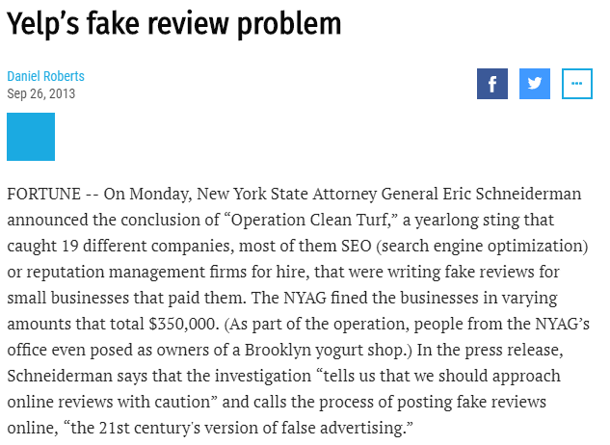
Motivation (2)

Slide 5
Motivation (3) Approach
This capstone project focuses on using Natural Language Processing and Machine Learning methods to identify deceptive content.

Slide 6
Motivation (4) Hypothetical Client
A hotel booking aggregator is trying to improve the quality and reliability of its hotel booking information for its users.
It has noticed complaints after users voiced concerns that some reviews may be fake.
To alleviate this, the client seeks to build a predictive model to flag whether reviews are genuine or fake.
By the end of this project, the client will be able to use this algorithm as part of their fake review deterrence strategy.

Slide 7
Data (1) Can you tell the difference?
 | Paid Reviewer | Real Reviewer
Positive | the experince at the hard rock hotel in chicago was fantastic,i will rate them a 6 out of 5. they have wonderful service and great staff and the view is just wonderful. | I recently stayed at the Hard Rock Hotel in Chicago, Il. From the start, the experience was bad. The room was filthy, there were no towels, and the front desk did nothing to rectify the situation. I will never stay there again. I could not have been more dissatisfied.
Negative | The Swissotel Chicago is a very mediocre hotel, the service is always poor, and the room service food always comes cold, unless it's supposed to be cold than it comes warm. I would rather stay at a super 8 than this place again. | I travel often for business and this hotel ranks very low on my list. The room had such a strong odor of smoke, it gave me a headache (and I used to be a smoker)! The room service was mediocre and extremely expensive. The hotel is disturbingly huge. Very difficult to navigate your way around it. I waited on hold for twenty minutes to ask a concierge where a pharmacy was located. She curtly gave me cross-street names and hung up. Uhhhhh, how do I know which direction to go in??? Stains on the carpet in the room. A big gauge in the wall, where maybe a thermostat once was??? The shower is decent. All in all, for the price they charge, NO THANKS!!! I'm just glad my company is footing the bill.

Slide 8
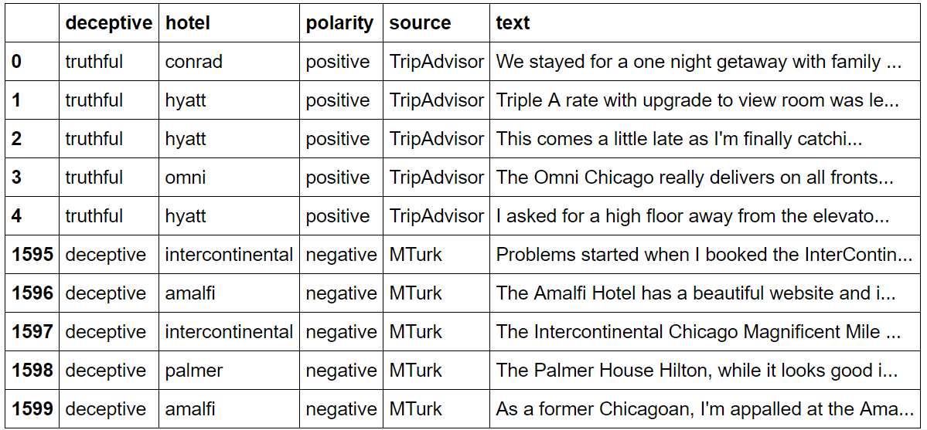
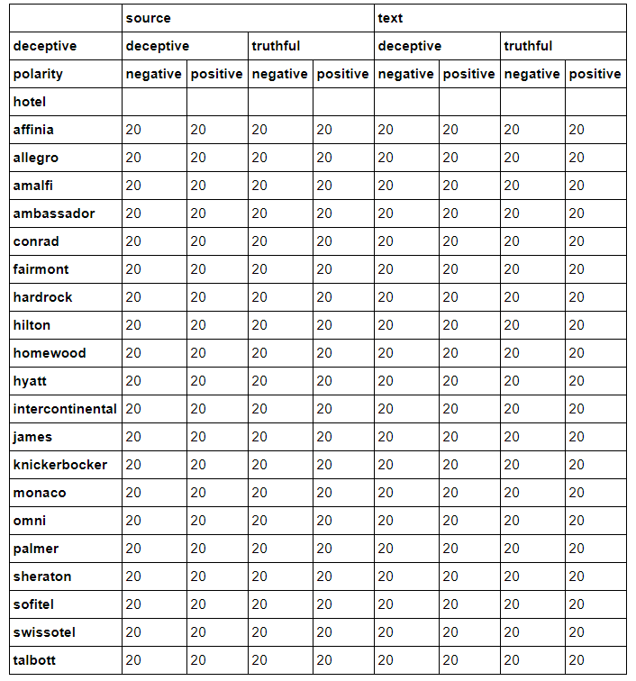
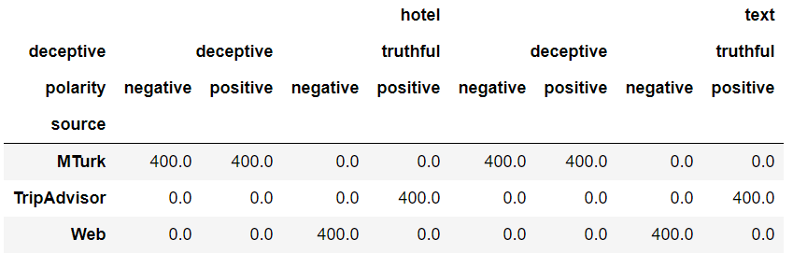
Data (2) Descriptives
Top 5 and Bottom 5 Records
Count of records by Deceptive, Sentiment, and Hotel
Positive and Negative Sentiment by Source

Slide 9
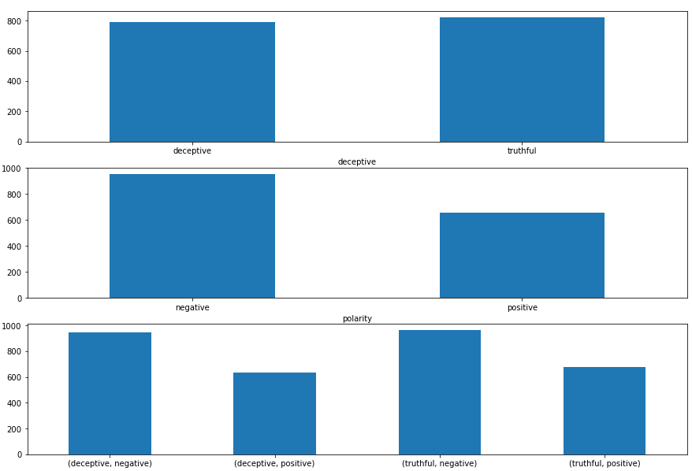
Data (3) Data Exploration
Mean Length of Words Across Categories
From the results of hypotheses tests we can see that:
There is a statistically significant difference between positive and negative average length of words (p-value of about 0)
There is a statistically significant difference between trip advisor and non trip advisor sources (p-value of about 0)
There is a no detectable statistical significance when it comes to deceptive and genuine reviews. (p-value = .2)

Slide 10
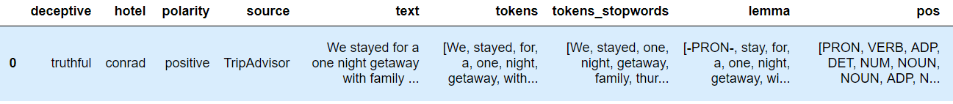
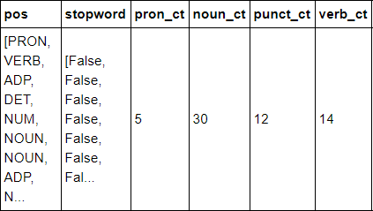
Data Preparation: Tokenizing
Sentence → Tokens → Parts of Speech
Parts of Speech → 4 Parts of Speech Variables

Slide 11
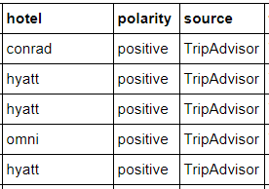
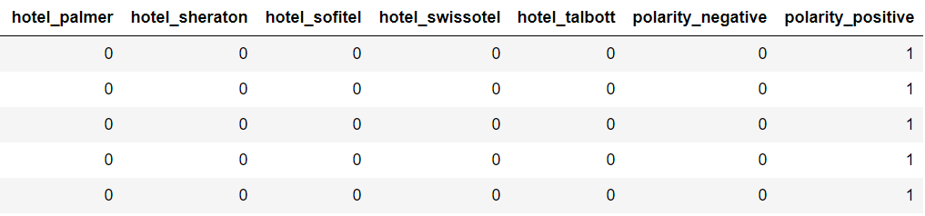
Data Preparation: Categorical Data
Categorical Data → Dummy Variables (22 Variables)

Slide 12
Topic Modeling
Use Latent Semantic Indexing
Data Reduction Technique based on “Singular Value Decomposition”
Reduces Tokenized Table for each of 1600 review into 300 variables
Think of each variable as a “topic” for example:
“An amazing Family Vacation” Topic
“Honey moon gone awry review” Topic
Frequency
Every Word
Weight
300 Topics
LSI w
300 Topics
1600 Reviews
1600 Reviews

Slide 13
Classification
6 Classification Models
Logistic Regression
Linear Discriminant Analysis (LDA)
K Nearest Neighbor Classification
Decision Trees
Naive Bayes (NB)
Support Vector Classifier (SVM)
Random Forest (RF)
Three sets of Features:
X1 = Topics Only (300 Variables)
X2 = Topics + Parts of Speech Metrics (300 + 4)
X3 = Topics + Parts of Speech Metrics + Dummy Variables (300 + 4 + 22)

Slide 14
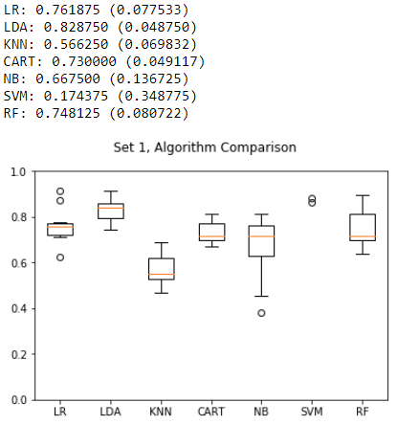
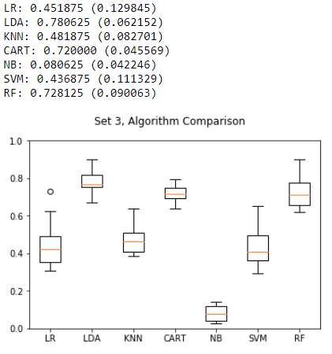
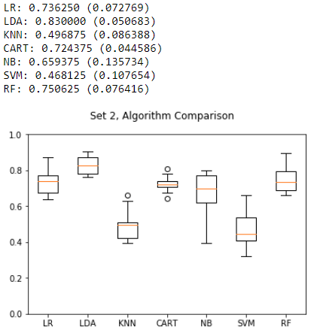
Model Selection (1)
Previous + Parts of Speech Metrics
Topics Only
Previous + Dummy Variables
LDA performs the best.

Slide 15
Model Selection (2)
LDA has no hyper parameters to be tuned
Results might be improved by using Random forest with tuned parameters given that without tuning, the model performed reasonably well

Slide 16
Optimizing Random Forest
Number of Trees to grow: 1000
Depth of Trees: [15,25,50,75],
Determine node splits by using Gini Entropy
Minimum Number of Samples in each node: [50,100]
Using: 10-Fold Cross Validation

Slide 17
Results (1)
Best Accuracy: 84.6%
1.6 % improvement compared to LDA
+ 20% improvement compared to untuned Random Forest model
Best Model:
Max Tree Depth = 50
Minimum Samples per Node = 50

Slide 18
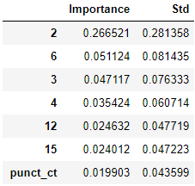
Results (2)
Mean Decrease in Impurity (MDI), we can determine feature importance.
The figure to the right shows what is most important in determining Deceptive vs Genuine reviews
Topic Vectors and 3 are most important
The use of punctuation is important

Slide 19
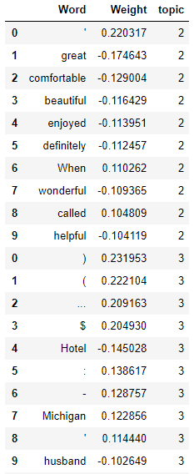
Results (3)
Looking into each topic vector, we see what types of words impact deceptiveness of a review

Slide 20
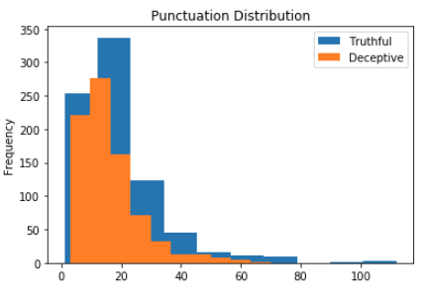
Results (3)
Descriptively, there is a noticeable difference in punctuation count between truthful and deceptive reviews.

Slide 21
Future steps
The results above suggest that the model performs fairly well under Random Forest, yet here are some areas of improvement and/or further areas of research.
The number of features is large compared to the number of observations
Potentially, tune LSI, reduce the Term Frequency-Inverse Document Frequency to a smaller number of topics
Word misspellings in feature engineering. Train the models with a misspelling indicator, as this could be a feature that might be important.
Look at this data across time -- there could be difference in detecting spam based on information around the time period -- for example, will adding month pick up information about holidays and the holiday vacation experience that could help detect fake reviews.
Would having transaction data on each review show interesting results -- for example, the time of each post, and location of the IP address that sent the post.

